Slide 1
Mechanisms and Sensors for Robotic Fingers
Shant Gananian, Pascal Weiner and Tamim Asfour
Seminar: Humanoide Roboter, WS 2018/19

Slide 2
Contents
Introduction
Key issues
1. Number of Fingers and Compliant Structure
2. Built-in or Remote Actuation
3. Transmission
4. Sensors
5. Materials and Manufacturing
Future Trends
Conclusion
References

Slide 3
Introduction
The human hand as an inspiration
Goals and application
Making a anthropomorphic hand (anthropomorphic approach)
Making an efficient manipulator (minimalistic approach)
Aspects of comparison
degrees of freedom DoF, degrees of actuation DoA, weight, force/load capacity, sensors, type of actuation, transmission and number of fingers.
Key issues discussed here
1- Number of Fingers and Compliant Structure
2- Built-in or Remote Actuation
3- Transmission System (in case of remote actuation)
4- Sensors
5- Materials and Manufacturing

Slide 4
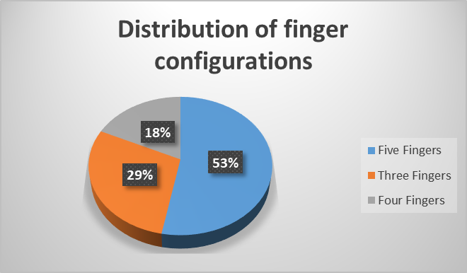
1.1. Number of Fingers and Compliant Structure
* Daniel R. et al. (2017) From 3 fingers to 5 fingers dexterous hands, Advanced Robotics
The correct hand is dependent upon the tasks to be done and the environment in which such activities take place

Slide 5
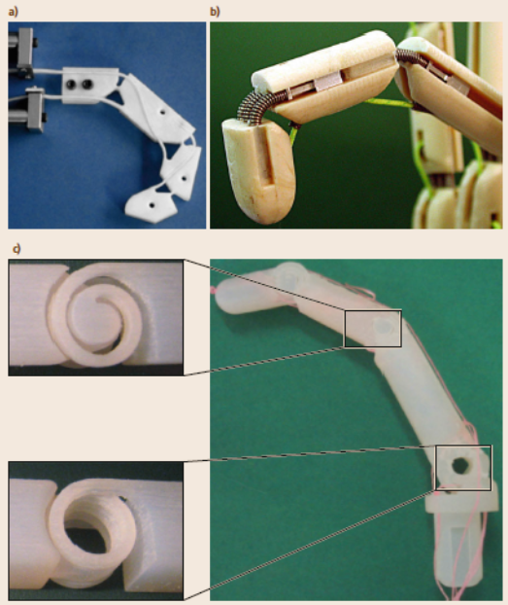
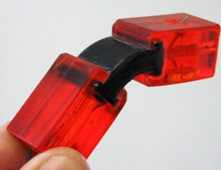
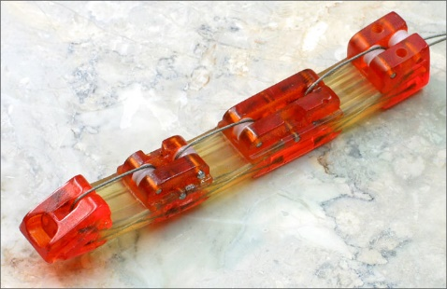
1.2. Number of Fingers and Compliant Structure
Compliant Joints:
Advantages:
absence of wear backlash and friction
size and weight reduction
Rapid Prototyping
a) single teflon piece
b) metallic springs
c) rapid prototyping

Slide 6
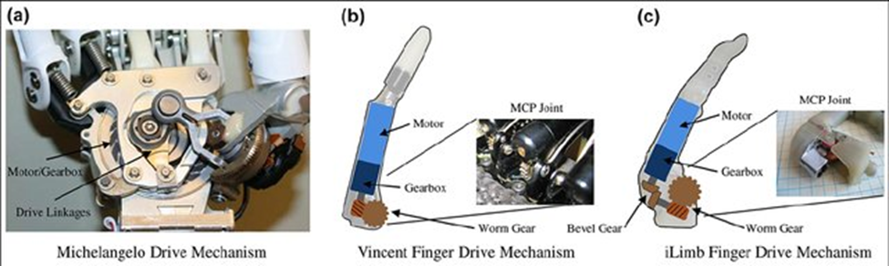
2. Built-in or Remote Actuation
Built-in Actuation:
Simplifying mechanical configuration of the joint
Reducing the transmission chain complexity
Joint motion is kinematically independent with respect to other joints
Motors occupy a large room inside the finger structure
Belter et al. Mechanical design and performance specifications of anthropomorphic prosthetic hands

Slide 7
3.1 Transmission
Flexible Link Transmission
pulley-routed flexible elements (tendons, chains, belts)
sheath-routed flexible elements (mainly tendon-like elements)
Actuators located remotely from joints
Achieving two-way control requires a pair (increased complexity)
Rigid Link Transmission
best stiffness proprieties to the transmission
low maintenance
bidirectional control of the joint
increases the weight, complexity and sometimes dimensions of the hand

Slide 8
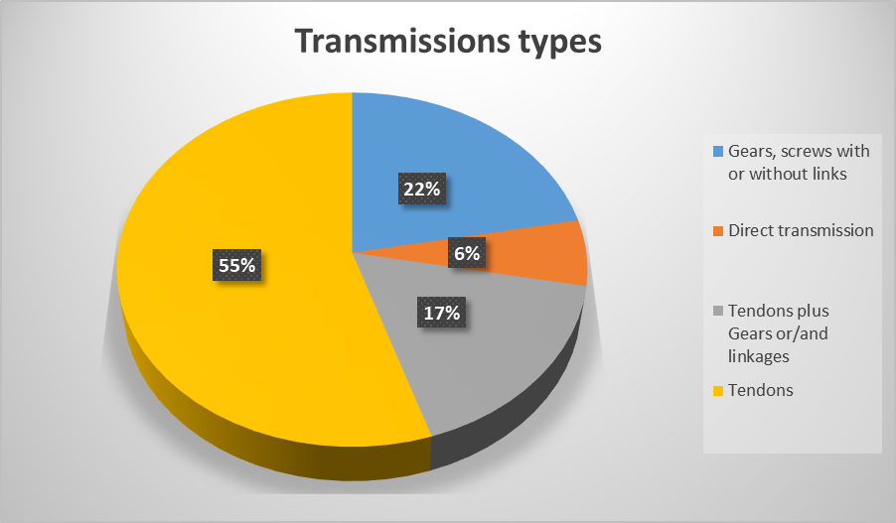
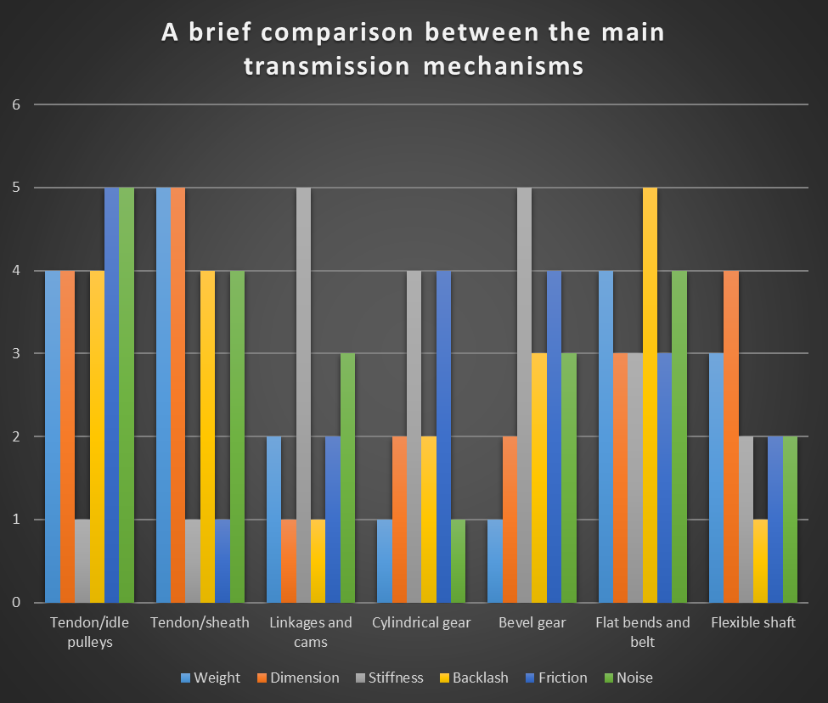
3.2. Transmission
* Balasubramanian et al. The human hand as an inspiration for robot
hand development

Slide 9
4. Sensors
Proprioceptive Sensors
Measures physical information related to the state of the device itself (e.g., position, velocity, and so on)
Exteroceptive Sensors
Measures the data related to the interaction with objects/environment (e.g., applied forces/torques, friction, shape, and so on)

Slide 10
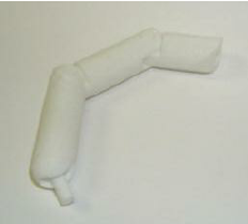
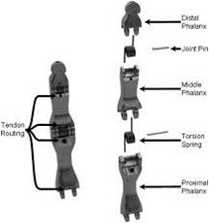
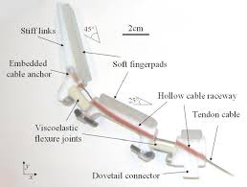
5.1. Materials and Manufacturing
Traditional machinery techniques is a rather long and expensive process
Rapid prototyping techniques provides several advantages
The chance to develop parts with complex geometry
Selective Laser Sintering (SLS)
high-strength, nickel-coated thermoplastic
polymer-based Shape Deposition Manufacturing (SDM)

Slide 11
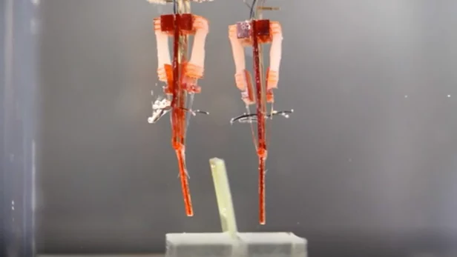
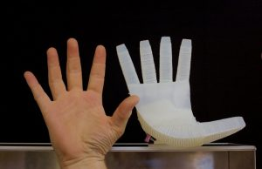
5.2. Materials and Manufacturing
Materials close to the human skin
The physiology of the human finger
The Skin
The soft tissue
The bone
The nail
Japanese researchers have developed a way to integrate living muscle tissue into robots
Soft robots are made with highly compliant materials such as fluids, gels and polymers so they can mimic functions present in living organisms

Slide 12
Future Trends
Development of artificial skins with denser spatial resolution and a multitude of sensor modalities.
Use of lightweight, low cost, compact and high precision actuator arrays.
Soft and compliant materials will often prevail when the hand is used to interact with humans
Sensors employed in smartphones will be employed by the artificial hands driving costs down and increasing reliability
Security and comfort are important issues to consider.

Slide 13
Conclusion

Slide 14
References

